Slide 1
Descriptive Epidemiology Study of the Justifying Patellar Instability Treatment by Early Results (JUPITER) Cohort
Meghan E. Bishop MD¹
Jacqueline M. Brady MD²; Shital Parikh MD, FACS³; Simone Gruber BA⁴; Joseph Nguyen MPH⁴;
Beth E. Shubin Stein MD⁴; and the JUPITER Group*
AOSSM 50th Annual Meeting
July 15, 2022
¹Rothman Orthopaedic Institute, New York, NY
²Oregon Health and Science University, Portland, OR
³Cincinnati Children’s Hospital, Cincinnati, OH
⁴Hospital for Special Surgery, New York, NY

Slide 2
JUPITER Group*
Surgeon | Sites
Beth Shubin Stein | Hospital for Special Surgery
Dan Green | Hospital for Special Surgery
Sabrina Strickland | Hospital for Special Surgery
Peter Fabricant | Hospital for Special Surgery
Jack Farr | Orthoindy
Kosmas Kayes | Orthoindy
Yi-Meng Yen | Boston Children's
Dennis Kramer | Boston Children's
Benton Heyworth | Boston Children's
Matthew Milewski | Boston Children's
Adam Yanke | RUSH Ortho
Surgeon | Sites
Jackie Brady | OHSU
Shital Parikh | Cincinnati Children's
Eric Wall | Cincinnati Children's
Marc Tompkins | U of Minnesota/TRIA
Caitlin Chambers | U of Minnesota/TRIA
Henry Ellis | Texas Scottish Rite
Philip Wilson | Texas Scottish Rite
Bob Magnussen | Ohio State University
Lauren Redler | Columbia
Jason L Koh | Northshore
Seth Sherman | Stanford
One or more authors has disclosures, see that section in agenda for details
Notes:
Thank all of the sites and surgeons of the JUPITER Group

Slide 3
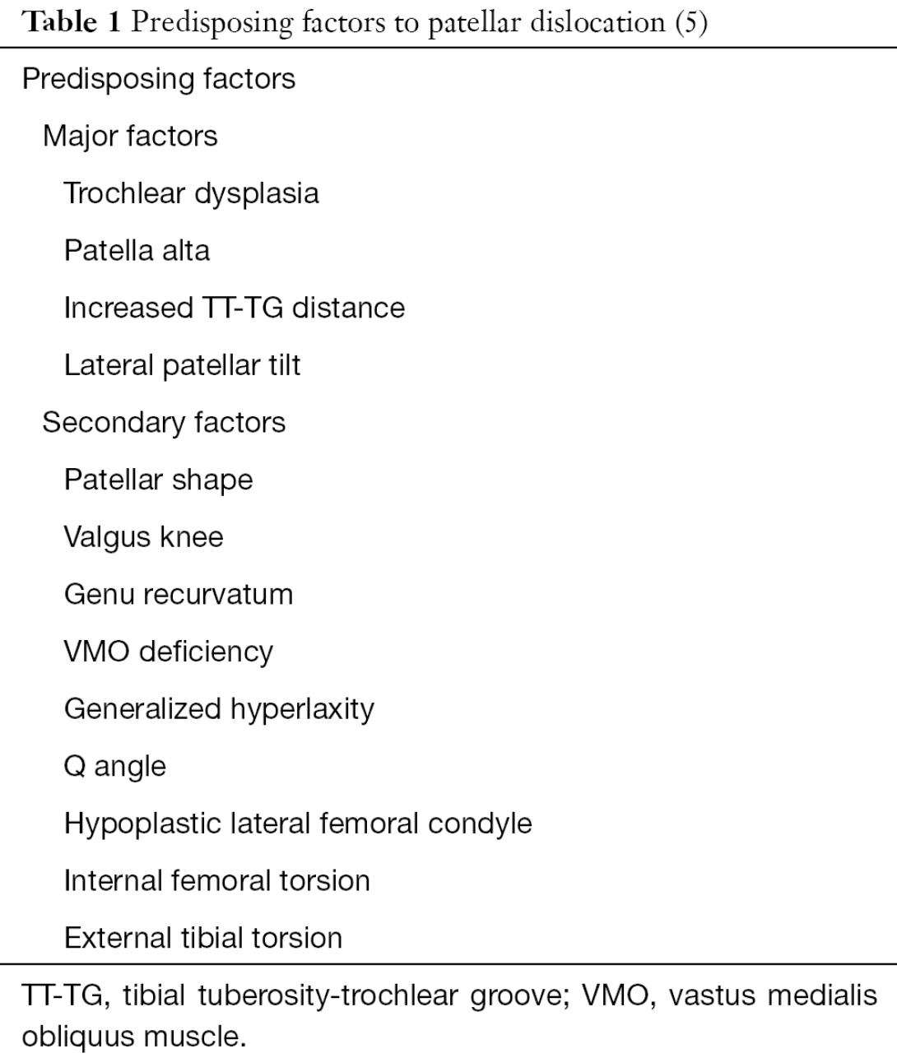
Introduction
Patellar instability incidence 5.8 to 77 per 100,000
Fithian et al. 2004> the highest risk to be amongst females 10 to 17 years old
Lewallen et al. 2013> Up to a ~70% risk of recurrence in patients with open growth plates and trochlear dysplasia
Placella et al. Annals Of Translational Medicine 2016
Notes:
5.8 in general population to 77 per 100,000 in younger with risk factors
In fithians original 2004 study, they demonstrated a fairly low risk of recurrence after a first-time dislocation (17% vs 49% for recurrent in their study) [3]; however, this study looked at all comers including young patients and old, and those with significant anatomic risk factors as well as those with fairly normal anatomy.
. Recent studies have identified risk factors that predict higher rates of recurrent dislocations and failure of non-operative treatment, including skeletal immaturity, contralateral dislocation, trochlear dysplasia, and excessive lateral patellar tilt6-9.
The more recent studies have separated these groups and come up with prediction models. Lewallen et al. demonstrated a nearly 70% risk of recurrence in patients with open growth plates and any degree of trochlear dysplasia [16]. The same group then increased their study population and determined that age under 25 years (not necessarily open physes) along with trochlear dysplasia was the most significant predictor of recurrence [23•].

Slide 4
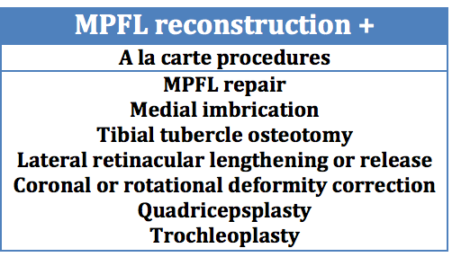
Introduction
Management of first time dislocations without loose body/fracture typically non-operative
For recurrent patellar instability, debate exists for ideal surgical procedure
Overall, outcomes not well established
Notes:
However, re-dislocation following first-time patellar dislocation has been reported in 15 to 44% of patients5,14-21. Amongst those who do not have re-dislocation, many continue to have functional limitations including persistent pain, partial giving way episodes (subluxation), or inability to return to sports2,5,18. In the absence of appropriate treatment, patients may develop recurrent instability and progressive chondral damage affecting the patellofemoral joint leading to worse long-term outcomes17,22,23
Though isolated MPFL reconstruction has shown promising results in the literature, there is reported 16-26% rate of complication associated with it26-28. Thus, some physicians recommend an ‘a-la-carte’ approach to correction of contributing factors besides MPFL reconstruction, including tibial tubercle osteotomy, tibial tubercle distalization, lateral retinacular lengthening or release, coronal or rotational deformity correction and/or trochleoplasty29-31. It is not known if, compared to isolated MPFL reconstruction, additional or combined surgeries would decrease the complication rate and/or improve functional outcomes.

Slide 5
Introduction
JUPITER (Justifying Patellar Instability Treatment by Early Results) is a hypothesis-driven, multi-center, multi-armed, prospective cohort study developed to obtain sufficient subjects to better describe clinical characteristics and predictors of clinical outcomes in the young patellar instability population
Notes:
It’s specific aims are to compare the safety and efficacy of (1) non-operative treatment, (2) isolated Medial Patellofemoral Ligament (MPFL) reconstruction, and (3) ‘à la carte’ surgical approach to treat patellar instability. Enrollment will take place for 3 years at 12 sports centers. Outcomes would be assessed at 6 months, 1 year, 2 years, 5 years and 10 years, including assessment of function, activity level, quality of life and complications.

Slide 6
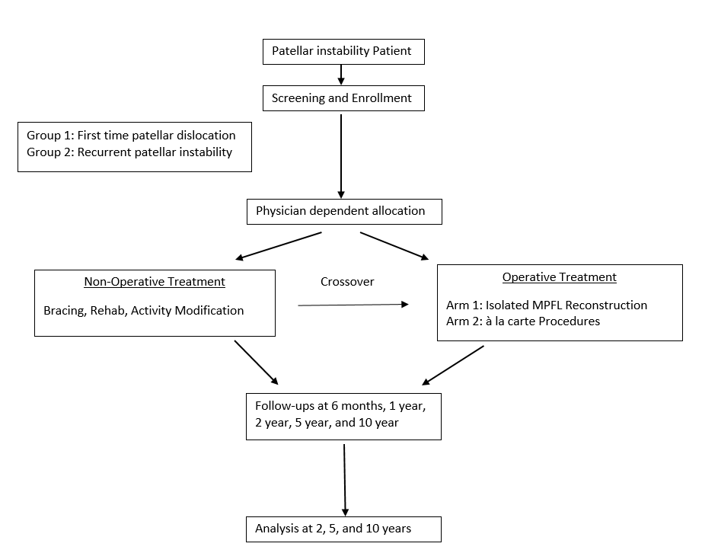
Introduction
Notes:
Multicenter study with 12 sites enrolling patients who sustained a patellar instability event.
Patients are divided into the groups: (1) non-operative treatment, (2) isolated Medial Patellofemoral Ligament (MPFL) reconstruction, and (3) ‘à la carte’ surgical approach to treat patellar instability. Enrollment will take place for 3 years at 12 sports centers. Outcomes would be assessed at 6 months, 1 year, 2 years, 5 years and 10 years, including assessment of function, activity level, quality of life and complications.
For operative group, treatment initiation is defined as date of surgery. For non-operative group, treatment initiation is defined as date of patient’s first encounter with the physician.
Period of immobilization (3-4 weeks) and physical therapy protocols (4-8 weeks) would be standardized in principle
The long-term (5 and 10 years) follow-up of patients with patellar instability in the current study, with or without surgical treatment, would allow to study the influence of various factors on development of patellofemoral arthritis

Slide 7
Purpose
The purpose of this study is to describe the formation of JUPITER and to provide objective analysis of patient demographics and patellar instability characteristics at baseline.

Slide 8
Methods
After training and IRB approval, surgeons began enrolling patients 10-35 years of age who had experienced a patellar instability event.
Radiographs, MRI and clinical assessments were evaluated to confirm patellar dislocation.
Inclusion Criteria | Exclusion Criteria
1. Documented episode of patellar dislocation (first episode or recurrent episodes) or, 2. Patellar Subluxation or, 3. Habitual or Permanent patellar dislocation or, 4. Congenital or Syndromic Patellar dislocation or, 5. Previous patella instability surgery 6. Ages 10-35 years | 1. Multiple ligamentous injury (total knee dislocation) 2. Age > 35 years 3. Non-English speaking 4. Significant developmental delays which would impact patient reported outcomes.
Notes:
Inclusion Criteria
Documented episode of patellar dislocation (first episode or recurrent episodes)
- Age: 10-25 years
- Hypermobility instability (eg Ehlers Danlos Syndrome)
- Habitual patellar dislocation
Exclusion Criteria
- Neuromuscular disorder (eg: Cerebral Palsy)
- Congenital or permanent patellar dislocation
- Multiple ligamentous injury (Knee dislocation)
- Significant other health conditions or developmental delays
Inclusion Criteria
Documented episode of patellar dislocation (first episode or recurrent episodes)
Patellar Subluxation
Habitual or Permanent patellar dislocation
Congenital or Syndromic Patellar dislocation
Previously failed Patellar Surgery
- Age: < 30 years
Exclusion Criteria
- Multiple ligamentous injury (Knee dislocation)
- Age > 30 years

Slide 9
Methods
Baseline Information
Patient demographics
Dislocation history
Physical exam characteristics
Baseline validated patient reported outcome scores Kujala score, Pedi-IKDC, HSS – Pedi FABS activity level score, Banff patella Instability Instrument and KOOS scores
Patient IQ registry platform
The cohort was divided between first-time vs recurrent dislocators and between conservative vs operative treatment.
Notes:
Data collected included …
Conservative versus operative management was based on treating physician’s preference following standard of care guidelines.
PE: J sign, beighton score, creptius
STATS info

Slide 10
Results
As of December 31st, 2021, 22 surgeons from 12 different sites had prospectively enrolled a total of 1825 patients, 2,073 knees.
62% female, 38% male; average age 19.1 years old
Site Name
Cincinnati Children’s Hospital Medical Center Hospital for Special Surgery NorthShore University OrthoIndy University of Minnesota/TRIA Texas Scottish Rite Hospital Oregon Health and Science University Boston Children’s OSU Medical Center Columbia University RUSH Orthopedics Stanford University
Notes:
Columbia
Will be 13- adam yanke

Slide 11
Results
Demographics
14.5% reported a family history of patellar dislocation
Notes:
300 out of 2073 reported. Out of the 330, 153 were mother. (46%) (7% of total)
60% none
Don’t know 21%

Slide 12
Results
Recurrent Dislocators vs Treatment Group
63% of patients reported that they had had greater than 1 dislocation
47% first time dislocators vs. 87% recurrent dislocators indicated for operative treatment
Notes:
73% knees were enrolled in the operative group and 27% in the conservative group
Operative treatment was indicated in 33.1% of first-time dislocators; 38.6% were due to presence of an osteochondral fracture.
1303 indicated they had multiple dislocations out of the 2073. - 62.85%
Operative only, 1511 total patients.
1135 recurrent dislocations treated with surgery – 75%
348 first time dislocation treated with surgery – 30%
28 unknown – 2%
Non-Op group, 562 total patients.
169 recurrent – 30%
389 first time - 69%
4 unknown -0.7%
For the second text box.
Total First time dislocations 737
Non-op treatment first time 389/737 – 53%
Op treatment first time 348/737 – 47%
Total recurrent dislocations 1303
Non-op treatment 169/1303 – 13%
Operative treatment 1135/1303 87%

Slide 13
Results
Average Number Recurrent Dislocations
Mean number of recurrent dislocations was 6.9 (Mean operative group 7.2 vs. non-operative group 5.1, p>0.05)
Notes:
The mean number of recurrent dislocations was 7.7 (Mean operative group 8.0 vs. non-operative group 5.5).

Slide 14
Results
Mechanism of Injury (1st Dislocation)
16% reported a contact injury while 68% reported a non-contact injury. 16% were not sure.
No difference between first time and recurrent dislocators (74% vs 66% noncontact)
29% required a manual reduction
Notes:
16.7% of the operative group versus 21.2% of the non-operative group reported a contact injury at the time of first dislocation.
34% required a manual reduction (either by patient, someone on field or in ER- 17% of that required an ER Reduction)

Slide 15
Results
Mechanism of Injury (Last Dislocation)
8% reported a contact injury while 74% reported non-contact injury. 17% were unsure.

Slide 16
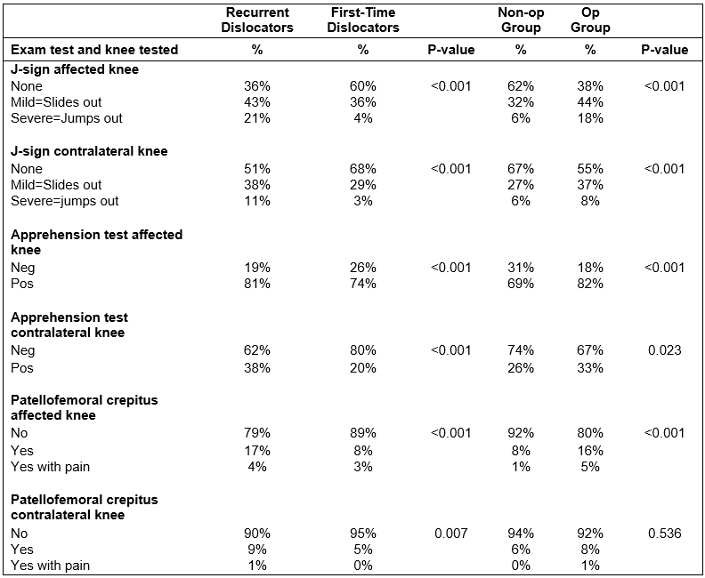
Results
Physical Exam Characteristics
Involved knee J-sign, apprehension, crepitus significantly more + in recurrent and operative groups (p<0.0001)
Contralateral knee J-sign and apprehension significantly more + in recurrent and operative groups (p<0.0001)
Notes:
When looking at physical exam characteristics, we found that recurrent and operative group patients have a higher % of positive tests on the affected knee, but also the contralateral side was also significantly higher in positive tests than first-time patients (except for the crepitus test, p=0.648).
52% noted to have a positive J sign in the involved knee
78% mild
22% severe

Slide 17
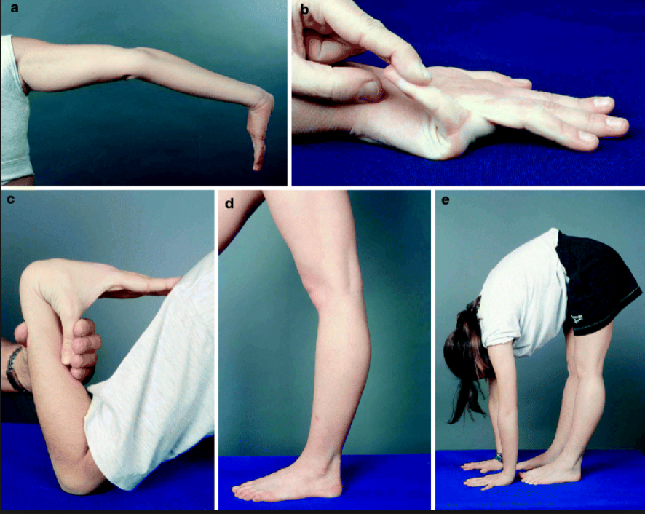
Results
Physical exam characteristics
Recurrent group nearly twice as likely to be ligamentously lax compared to first-time patients (p=0.08)
Sanchis-Alfonso et al. (2011) Biomechanical Bases for Anterior Knee Pain and Patellar Instability
Notes:
On the contralateral side, recurrent patients were twice as likely to have had mild or severe J-sign compared to first-time patients (OR: 2.25, 95% CI: 1.59 to 3.19, p<0.001).
Redler paper
Factors Associated With High-Grade Lachman, Pivot Shift, and Anterior Drawer at the Time of Anterior Cruciate Ligament Reconstruction
Chronic ACL tears, generalized ligamentous laxity, and meniscus tears are associated with increased odds of high-grade laxity with all 3 tests. Female patients and age younger than 20 years are associated with increased odds of a high-grade pivot-shift test.
Arthroscopy. 2016 Jun;32(6):1080-5. doi: 10.1016/j.arthro.2015.11.018. Epub 2016 Jan 25.
Factors Associated With High-Grade Lachman, Pivot Shift, and Anterior Drawer at the Time of Anterior Cruciate Ligament Reconstruction.
Magnussen RA1, Reinke EK2, Huston LJ2; MOON Group, Hewett TE3, Spindler KP4.

Slide 18
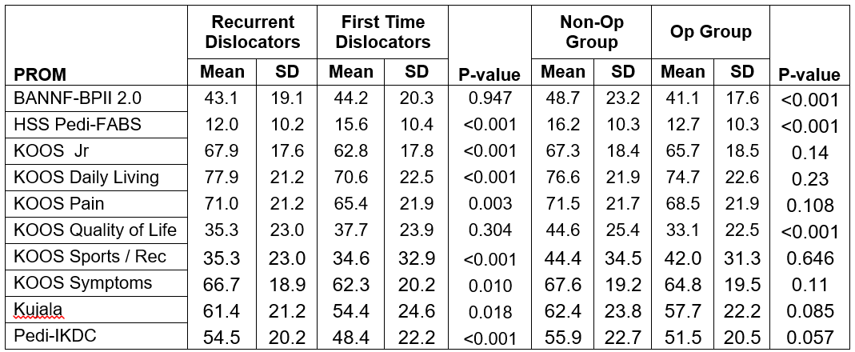
Results
Baseline Patient Reported Outcome Scores
Baseline PROs varied with the recurrent group having lower Pedi-FABS (p<0.001) scores and LOWER Kujala (0.018), HIGHER KOOS ADL (<0.001), KOOS Sports (<0.001), KOOS Pain (0.003), KOOS Symptoms (0.010) and LOWER Pedi-IKDC (<0.001) scores than the first-time dislocator group.
Notes:
Baseline PROs varied with the recurrent group having lower Pedi-FABS (p<0.001) scores and higher Kujala (0.034), KOOS ADL (<0.001), KOOS Sports (<0.001), KOOS Pain (0.006), KOOS Symptoms (0.015) and Pedi-IKDC (0.002) scores than the first-time dislocator group. Recurrent dislocators were more likely to have positive physical exam findings on both knees and lower activity scores. However, the knee specific outcome scores were higher in patients with recurrent dislocations which may reflect adaptive mechanisms to improve function.
Generally showing higher scores in PROs representing ADLs and lower in sporting activities. THis could be related to compensatory adaptation methods developed for daily activities for the recurrent group.
This finding is similar to a 2017 MOON database publication showing higher ADL PROs in patients with chronic ACL tears and lower in sporting activity scores
Conclusion: After controlling for age, sex, competition level, smoking, and BMI, patients in the chronic ACLR group participated in less pivoting and cutting sports but reported better pain/function. Whether decreased activity is deliberate after an ACL injury or patients who undergo chronic ACLR are simply less active and may be treated successfully without surgery warrants further investigation. Nonrandomized studies that utilize PROMs should consider time from injury in study design and data interpretation.
However, at baseline, Pedi-FABS scores were lower in the recurrent group versus first-time (p=0.001). KOOS-QoL scores were lower in the recurrent group (0.008).
In addition to the Kujala (0.009), higher scores were also seen in the KOOS ADL (0.008), KOOS Sports (<0.001), and Pedi-IKDC (0.014) scores at baseline for recurrent patients.
Am J Sports Med. 2017 Mar;45(3):541-549. Epub 2016 Nov 1.
Does the Chronicity of Anterior Cruciate Ligament Ruptures Influence Patient-Reported Outcomes Before Surgery?
Nguyen JT1, Wasserstein D2, Reinke EK3, Spindler KP4, Mehta N5, Doyle JB5; MOON Group, Marx RG6.
recurrent patients tend to develop an adaptation to having a likelihood of another dislocation episode. It's as if we come up with compensation mechanisms that allow us to still be "normally" functioning as is indicated in the ADL and IKDC scores. But not a surprise that the volume of sporting activity is lower in the recurrent group as indicated in the lower Pedi-FABS scores. Also, since you're looking at the entire JUPITER cohort, this may vary depending on the age of the patient as well. We may see more consistent findings if we were to stratify this by age groups potentially

Slide 19
Limitations
Descriptive nature of study
Challenges of coordinating between multiple sites and investigators
Outcomes TBD
Notes:
Only include baseline data
Limitations include the descriptive nature of this study that require further follow-up to assess these factors as predictors for outcomes of treatment in patellar intstability
Potential limitations for MARS include the feasibility of
coordinating 87 investigators and obtaining greater than
80% patient 2-year follow-up.
Why
Enrolling for 5 years
Now includes revisions, syndromic, all comers
Ask simone for enrollment update- currently enrolling more patients

Slide 20
Conclusions
The JUPITER Group has been able to accumulate the largest prospectively collected patellar instability database to date
Over half (63%) of patients sustained more than one dislocation
Operative management indicated 44% first time dislocators vs 85% recurrent dislocators
Operative management was associated with the presence of an osteochondral fractures as well as an increased prevalence of instability-related physical exam findings including a J-sign and patellar apprehension.
PRO scores varied between first time and recurrent dislocators
Notes:
In a large prospective cohort, operative management following first-time patellar dislocation was more common than previously reported.
Recurrent dislocators were found to have an increased proportion of instability-related physical exam findings but also demonstrated generally higher knee-specific outcome scores than first time dislocators. This suggests recurrent dislocators presenting for clinical evaluation may have less individual dislocation episode-related disability but longer chronologic disability due to multiple instability events.

Slide 21
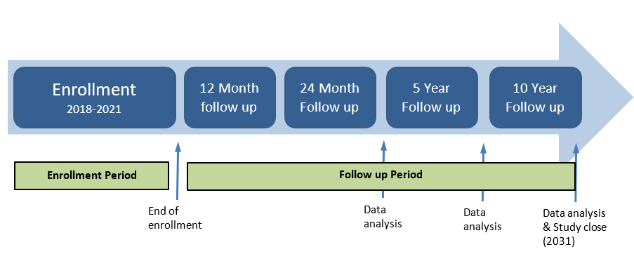
More to Come from JUPITER
Notes:
This prospective study provides insights related to the demographics, chronology, and physical exam findings of patients with first-time and recurrent patellar instability. These factors can help better characterize subjective outcomes and disability due to instability as well as provide comparisons of operative and non-operative outcomes in a longitudinal, prospective fashion

Slide 22
Notes:
Sanchis-Alfonso V., Ávila-Carrasco C., Prat-Pastor J.M., Atienza C.M., Cuñat E. (2011) Biomechanical Bases for Anterior Knee Pain and Patellar Instability. In: Sanchis-Alfonso V. (eds) Anterior Knee Pain and Patellar Instability. Springer, London

