Slide 1
Reliability of Radiologic Assessments of Clinically Relevant Growth Remaining in Knee MRIs of Children and Adolescents with Patellofemoral Instability
Peter D. Fabricant, MD¹; Madison Heath, BS¹; Matthew William Veerkamp, BA²; Simone Gruber, MS¹; Daniel W. Green, MD, MS, FACS¹; Sabrina M. Strickland, MD¹; Eric J. Wall, MD²; Douglas Mintz¹; Kathleen H Emery, MD²; The JUPITER Group*; Beth E. Shubin Stein, MD¹; Shital N. Parikh, MD FACS²
¹ Hospital for Special Surgery, New York, NY, USA
² Cincinnati Children’s Hospital Medical Center, Cincinnati, OH, USA
The JUPITER group: Jacqueline Brady, MD; Henry B. Ellis, MD; Jack Farr, MD; Benton E. Heyworth, MD; Jason L. Koh, MD, MBA; Dennis Kramer, MD; Robert Magnussen, MD; Lauren Redler, MD; Seth Sherman, MD; Marc Tompkins, MD; Philip Wilson, MD.
Acknowledgements: Matthew Milewski, MD; Yi-Meng Yen, MD; Adam Yanke, MD.

Slide 2
Disclosure
The authors have nothing to disclose.

Slide 3
Introduction
Skeletal maturity status influences surgical decision making and planning in children and adolescents with patellofemoral instability.
Consistent and accurate assessment of the growth remaining in the physis is vital for medical decisions and surgical techniques.
This study examines the interrater reliability among surgeons evaluating physeal status of adolescent patellofemoral instability patients.

Slide 4
Methods
Cross-sectional reliability study on prospectively collected data
6 fellowship trained Orthopaedic surgeons specializing in patellofemoral instability were used as raters.
20 blinded and randomized knee radiographs and MRIs were examined for distal femoral and proximal tibial physeal status.

Slide 5
Methods
Phsyeal status was categorized as either: Open Physis (clinically relevant growth remaining) or closed/closing physis (no clinically relevant growth remaining)
After the initial round of evaluation raters discussed consensus methods to improve reliability and a second round of evaluations were done.
Fleiss’s kappa was calculated for each measurement.

Slide 6
Example of low signal along the entire distal femoral physis (white arrows) on intermediate-weighted TE coronal MRI sequence, based on the new consensus criteria of an “open” distal femoral physis
The low signal along the proximal tibial physis is interrupted (black arrows), which would be classified as “closing/closed.”
Since one of the two physis is ‘closing’, the patient is considered skeletally mature

Slide 7
Results (Tables 1 and 2)
Initial reliability between the surgeons was poor (Kappa range: 0.01-0.58). It was based on radiographs and MRI
After consensus building almost perfect interrater reliability was achieved (Kappa=0.99 for all measurement). It was based on MRI only

Slide 8
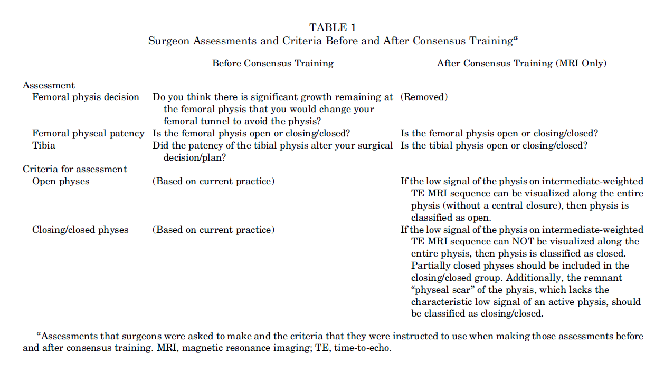

Slide 9
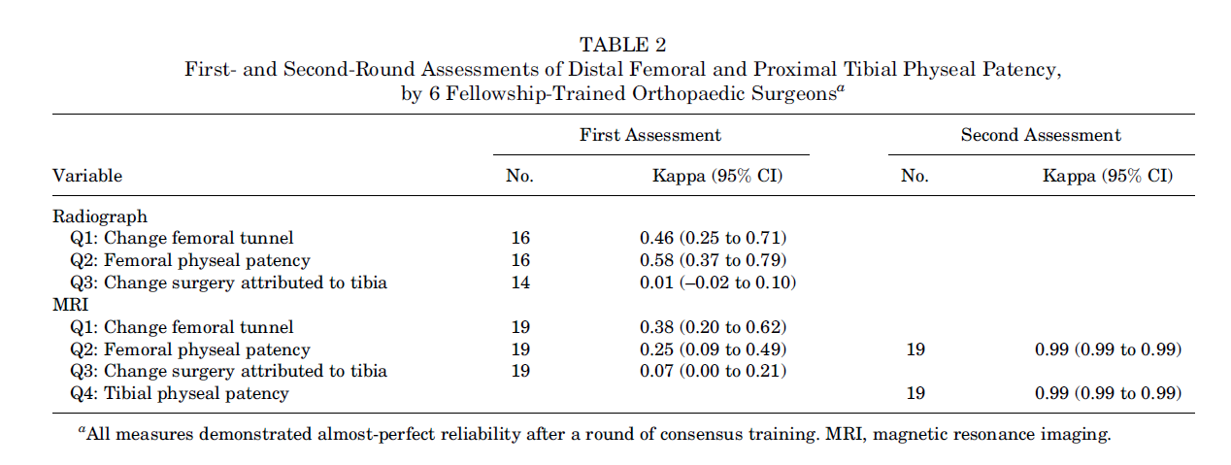

Slide 10
Conclusion
Radiographs of knee were unreliable for determination of skeletal maturity
MRI of knee was reliable for determination of skeletal maturity based on assessment of distal femoral and proximal tibial physis
Surgeons should focus on using reliable imaging metrics in children and adolescents with patellofemoral instability, and measurements that remain unreliable after consensus building and training should be removed from clinical decision-making algorithms.

Slide 11
References
George J, Nagendran J, Azmi K. Comparison study of growth plate fusion using MRI versus plain radiographs as used in age determination for exclusion of overaged football players. Br J Sports Med. 2012; 46(4):273-278.
Pennock AT, Bomar JD, Manning JD. The creation and validation of a knee bone age atlas utilizing MRI. J Bone Joint Surg Am. 2018; 100(4):e20.
Sasaki T, Ishibashi Y, Okamura Y, Toh S, Sasaki T. MRI evaluation of growth plate closure rate and pattern in the normal knee joint. J Knee Surg. 2002;15(2):72-76.
Xi H, Roche AF. Differences between the hand-wrist and the knee in assigned skeletal ages. AmJPhysAnthropol. 1990;83(1):95-102.

