Slide 1
Technique Variation for MPFL Reconstruction in Skeletally Immature Patients: Data from the JUPITER Cohort
Benton E. Heyworth, MD¹, Sofia Hidalgo Perea, BS², Daniel W. Green, MD²,
Matthew Veerkamp, BA³, Eric J. Wall, MD³, Philip L. Wilson, MD⁴,
JUPITER Study Group, Beth E. Shubin Stein, MD², Shital N. Parikh, MD³
¹Boston Children’s Hospital, MA, USA
²Hospital for Special Surgery, NY, USA
³Cincinnati Children’s Hospital Medical Center, OH, USA
⁴Scottish Rite for Children, TX, USA

Slide 2
Author Disclosures
Benton E. Heyworth, MD
Receives royalties from Springer. Stock or stock options in Imagen Technologies.
Sofia Hidalgo Perea, BS, Matthew Veerkamp, BA, Eric J. Wall, MD,
No financial conflicts to disclose
Daniel W. Green, MD, MS, FACS
Receives royalties from Arthrex, Inc. and Pega Medical. Consultant for Arthrex, Inc.
Philip L. Wilson, MD
Receives royalties from Elsevier.
Beth E. Shubin Stein, MD
Receives royalties from Arthrex, Inc. Consultant for Arthrex, Inc.
Shital N. Parikh, MD
Receives royalties from Wolters Kluwer Health – Lippincott Williams & Wilkins

Slide 3
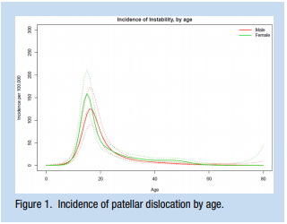
Background
Patellofemoral instability (PFI) has been the subject of significant and increased clinical and research interest in the adult sports community
However, it is primarily a pediatric problem, with an epidemiological peak in adolescence

Slide 4
Background
Despite management approaches and surgical techniques for pediatric and adolescent patellofemoral instability (PFI), there remains a lack of clear clinical guidelines and indications
While there are many approaches to surgical treatment, medial patellofemoral ligament reconstruction (MFPLR) is among the most commonly utilized surgical options.
Variation in technique remains significant, particularly in skeletally immature sub-populations, which has adverse implications on
Cost
Quality/effectiveness

Slide 5
Purpose & Methods
Purpose: Examine the variation in MPFLR technique
Patient study cohort: skeletally immature patients
Surgeon study cohort: 20+ orthopedic surgeons
Different experience levels
Specialty training backgrounds.
Data from the JUPITER (Justifying Patellar Instability Treatment by Early Results) cohort retrieved/analyzed
Multi-center (11 centers, 21 surgeons)
Multi-armed (op/non-op)
N = 2000+ pts (~75% operative, ~25% non-operative)

Slide 6
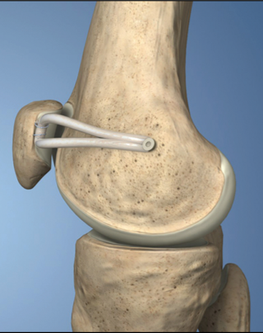
Purpose & Methods
All operative records of skeletally immature patients from 2016 to 2021 were retrieved from the JUPITER cohort
Inclusion/exclusion criteria:
Primary surgery (no revisions)
Single-stage MPFLR (no staged procedures)
Isolated MPFLR (no TTOs, other osteotomies)
Final study cohort: 205 knees

Slide 7
Results
Of the 306 skeletally immature knees, 205 (53% female, 47% male) met inclusion criteria and comprised the final cohort
Average age =13.6 ± 1.8 years (5.1-19.0)
Initial injury mechanism was of a non-contact nature in 73% and a result of contact in 17%
Variable ​ | Percentage (%)​
Age (years)*​ | 13.60 ± 1.84​
Sex​ | ​
Male​ | 47%​
Female​ | 53%​
Laterality​ | ​
Right​ | 44%​
Left​ | 56%​
Mechanism of Initial Injury ​ | ​
Contact​ Non-Contact​ Not Sure ​ | 17%​ 73%​ 10%​

Slide 8
Results
6 patients were <10 years old
5 patients were 17 or older

Slide 9
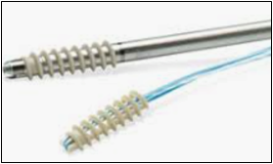
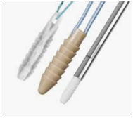
Results – Patellar Fixation
47% of surgeons utilized autograft while 53% utilized allograft
Suture anchors (including small tenodesis screws) were the most popular patellar fixation technique (61%), followed by the use of tunnel under a bone bridge (37%)
The majority of surgeons utilized 2 suture anchors (59%)
Variable ​ | Percentage (%)​
Graft Choice​ | ​
Autograft​ | 47%​
Allograft​ | 53%​
Patellar Fixation ​ | ​
Suture Anchors​ 1​ 2​ 3​ | 61%​ 24%​ 36%​ 1%​
Bone Bridge​ | 37%​
Soft Tissue Fixation ​ | 1.5%​
Docking Technique ​ | 0.5%​

Slide 10
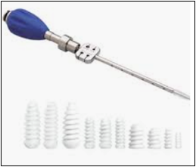
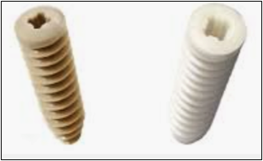
Results – Femoral Fixation
Screws were the most popular femoral fixation technique (84%), followed by suture anchors (12%)
The majority of surgeons used either 1 interference screw (81%) or 1 suture anchor at the femur (11.5%)
Variable ​ | Percentage (%)​
Femoral Fixation ​ | ​
Interference Screw​ 1​ 2​ | 84%​ 81%​ 3%​
Suture Anchors​ 1 ​ 2​ | 12%​ 11.5%​ 0.5%​
Other​ | 3.5%​
Soft Tissue Fixation of Free Graft​ | 0.5%​

Slide 11
Results – Concomitant Procedures
Lateral release was relatively uncommon (13%)
Hemi-epiphysiodesis (10%) 2nd most common concomitant procedure
OC Fxs (15%) – fixation 2x more common than RLB
Variable ​ | Percentage (%)​
Additional Procedures​ | ​
Osteochondral Fracture Treatment​ Removed​ Fixed​ Removed and Fixed​ | 15%​ 5.5%​ 9%​ 0.5%​
Lateral Retinacular Release​ | 13%​
Lateral Retinacular Lengthening​ | 2%​
Patellofemoral Chondroplasty​ | 25%​
Hemi- Epiphysiodeses​ | 10%​
Medial Quadriceps Tendon-Femoral ​ Ligament Reconstruction​ | 3%​
Grammont Realignment Procedure​ | 3%​
Cartilage Restoration Procedure​ | 1%​

Slide 12
Conclusion
Variation in different aspects of MPFLR technique is substantial among this large cohort of orthopedic surgeons
Given the well-established importance of decreasing variation for healthcare cost containment and optimization of outcomes, comparative studies and sub-stratified analyses are needed to better elucidate the most favorable techniques and their components

Slide 13
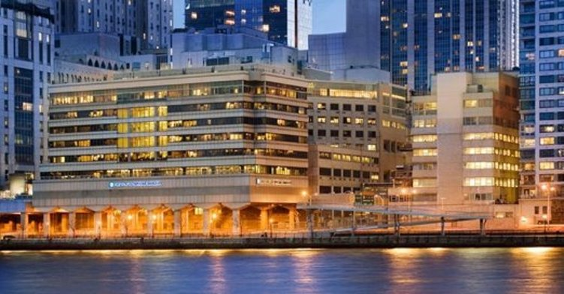
Thank you!
Click to add tex
Contact Information: Daniel W. Green, greendw@hss.edu

